Slide 1








Microsoft Defender Suite for Microsoft 365 Business Premium
Enhanced protection with Microsoft Defender Suite
Microsoft Defender Suite for Business Premium provides your organization with the advanced security capabilities, delivering comprehensive protection and response across identities, endpoints, apps, and email threats.
Zero Trust across your entire digital estate―Assume breach, verify each request, and fully authenticate and authorize every request before granting access.
Unified exposure management―Continuously assess security posture, enable proactive risk management and protection of assets.
Unified security operations platform―Leverage a single, integrated solution for end-to-end security operations, enhancing efficiency and protection across your entire digital estate.
Industry leader
Microsoft is the only security vendor recognized as a leader across 19 categories by Gartner, Forrester, and IDC. ¹
Protect your entire estate
Identity and access controls
Identity protection
Device security
Collaboration security
SaaS security
Risk-based conditional access and sign -in assessment
Visibility into risky sign-ins and user behavior anomalies
ID Governance and Privileged Identity Management
Threat and suspicious user activity detection
Built-in response and automated playbooks
Context-rich identity insights during investigations
Industry-leading antimalware and conditional access
Endpoint security and EDR with advanced threat hunting
Attack surface reduction capabilities powered by Secure Score
Advanced email and collaboration security with automated investigation and response
End user phishing simulation trainings
Visibility into “Shadow IT”
Uncovers configuration gaps and offers recommendations
LoB app monitoring, governance and protection
¹ Source: Microsoft ² Source: IBM Cost of a Data Breach Report, IBM, p. 6​
Notes:
67% of all phishing attacks utilized some form of AI
292
days to identify and contain breaches involving stolen credentials

Slide 2

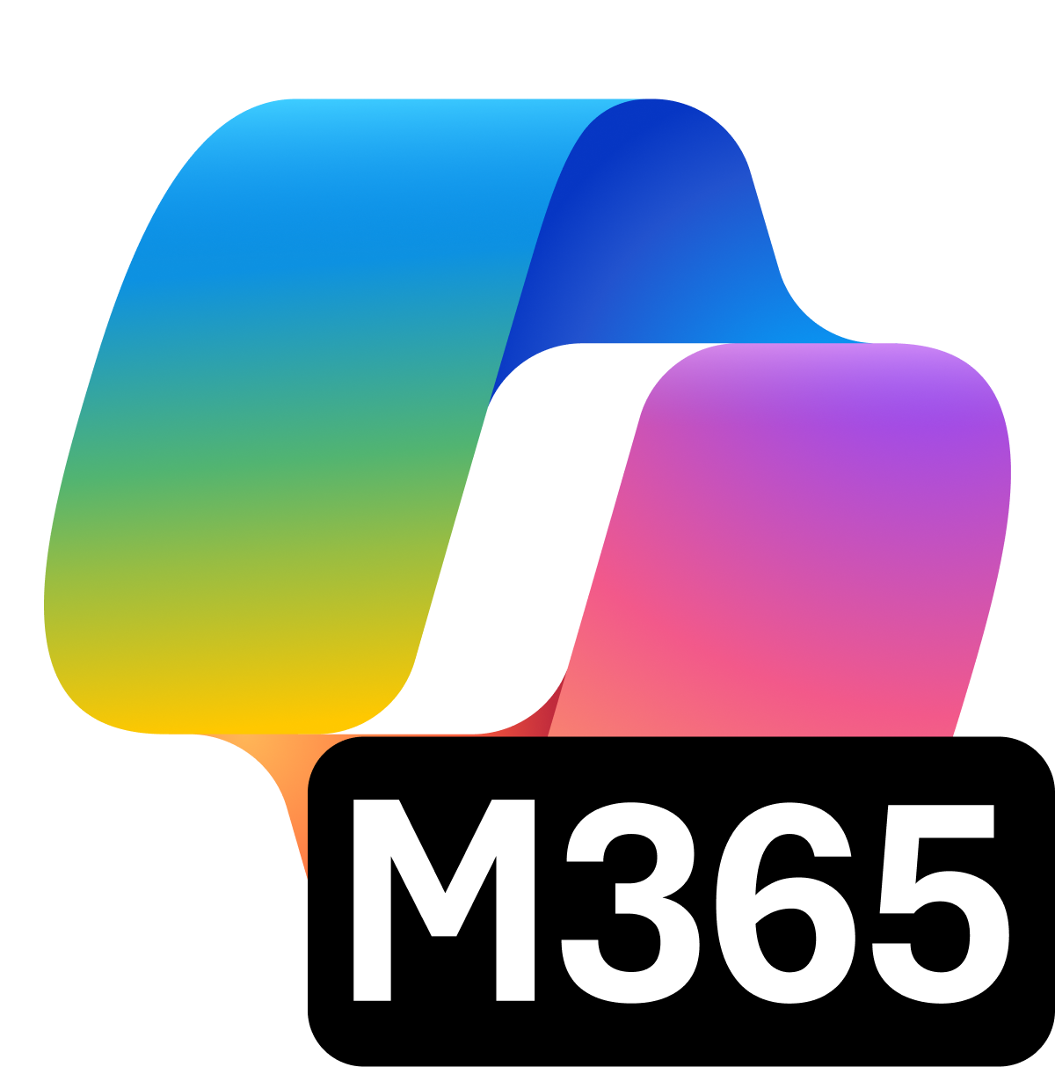


Microsoft Purview Suite for Microsoft 365 Business Premium
Intelligent compliance and risk management in the age of AI
AI transformation is happening now.
Secure and govern your data estate and get ready for AI
Microsoft Purview Suite, now available as an add-on to Microsoft 365 Business Premium, providers integrated data security and compliance capabilities critical for organizations looking to adopt Gen AI technologies and minimize risks related to regulatory requirements.
Safeguard sensitive data across clouds, apps, and endpoints.
Identify and remediate critical risks within your organization.
Investigate and respond to legal requirements with relevant data.
Built-in assessments and actions for 350+ regional regulations
Unified solutions to secure and govern data for the era of AI
Address oversharing concerns
Protect against data loss and insider risks
Govern AI use to meet regulations & policies
Gain visibility into overshared content.
Remediate excessive permissions.
Prevent Generative AI from processing sensitive files.
Get alerts and reports of risky behavior and AI use.
Protect sensitive files and Copilot interactions.
Dynamically apply security policies based on risky actions.
Inspect interaction content and audit logs.
Investigate for compliance and ethical violations.
Enforce lifecycle policies and legal holds.

Slide 3



What you get from Business Premium, Defender Suite, and Purview Suite?
Microsoft Defender for Office 365 Plan 2 | $5.00 | Automated investigation and response, and end user phishing simulation trainings
Microsoft Defender for Cloud Apps | $3.50 | Automatically discover and block apps based on risk level, unusual user activity, or data-sharing behavior
Microsoft Entra ID P2 | $9.00 | Risk-based conditional access, visibility into risky sign-ins and user behavior anomalies. ID Governance and Privileged Identity Management
Microsoft Defender for Identity | $5.50 | Identify, detect, and investigate advanced threats, compromised identities, and malicious insider actions
Microsoft Defender for Endpoint Plan 2 | $5.20 | EDR with advanced threat hunting, as well as access to threat experts for additional investigations
Microsoft Defender for IoT – EIoT² | $0.85* | Enables discovery of network devices, vulnerability management, and threat detection and response.
M365 E5 ​eDiscovery & Audit ​ | $6.00 | Integrated tools and deep visibility for legal and compliance teams to streamline investigations, enforce legal holds, and maintain regulatory readiness
Information Protection & Governance | $7.00 | Classify, protect, and manage sensitive data across its lifecycle, ensuring secure collaboration and compliance at scale
Insider Risk Management | $6.00 | Detect and mitigate internal threats with privacy-respecting behavioral analytics and granular communication controls
Microsoft Defender and Purview Suites
($15.00)
Prices – ERP /per user/per month
¹Only provided via Microsoft 365 E5 or Microsoft Defender Suite
²Per device per month

Slide 4
Upgrade investment snapshot from Business Standard to Business Premium, Defender Suite, and Purview Suite
Current SKU | {start_sku}​
# Seats | {seats}​
Current investment​ | {expiring_arr}
Upgrade solution​ | {target_sku}
# Proposed seats for upgrade​ | {add_proposed_seat}
Actual cost of the solution per user | {actual_price_per_user}
Incremental cost per user​ | {incremental_cost_per_user}​
Total incremental annual investment for {seats} seats | {overall_incremental_cost}
[NOTE - PLEASE DELETE BEFORE SENDING TO THE CUSTOMER]
The calculation above is based on active promos, partner MAICPP status, Microsoft Commercial Incentives, and Microsoft list price, and assumes additional information on margins. This is for reference only and subject to change. Please review the calculation, and adjust before sending it to the customer. Microsoft would not be responsible for the content or accuracy of any information/claim made in this document, or for any decisions made based on such information.

Slide 5
Enhance your security posture with [PARTNER NAME]
[INSTRUCTION FOR THE PARTNER] Partner to insert their personalized information on: Value proposition and methodology, experience, Microsoft services, advanced specializations, and past awards.
You can leverage Copilot Chat to customize this section! Add your website URL, upload this flyer on Copilot Chat, and prompt it to write a draft for this section.

